Slide 1
Graduate Artificial Intelligence CS 640 Temporal Difference and Q-Learning
Jeffrey Considine
jconsidi@bu.edu

Slide 2
Plan for Today
Assumptions of Iteration Methods
Temporal difference learning
Q-learning

Slide 3
What is the biggest assumption of Value and Policy Iteration?
???

Slide 4
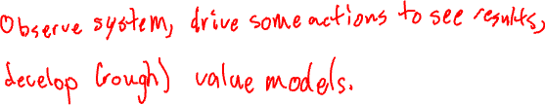
What Can We Do Without That Assumption?
???

Slide 5
Any Questions?
???

Slide 6
Model-Free Reinforcement Learning
Model-free = no explicit model of rewards and transitions
Reinforcement learning
Catchall term for learning optimal actions…
Mostly behavior reinforcement from rewards (like the phrase in psychology)
Estimates for some states and/or actions based on other estimates…
Previous value and state iteration methods could be considered examples.

Slide 7
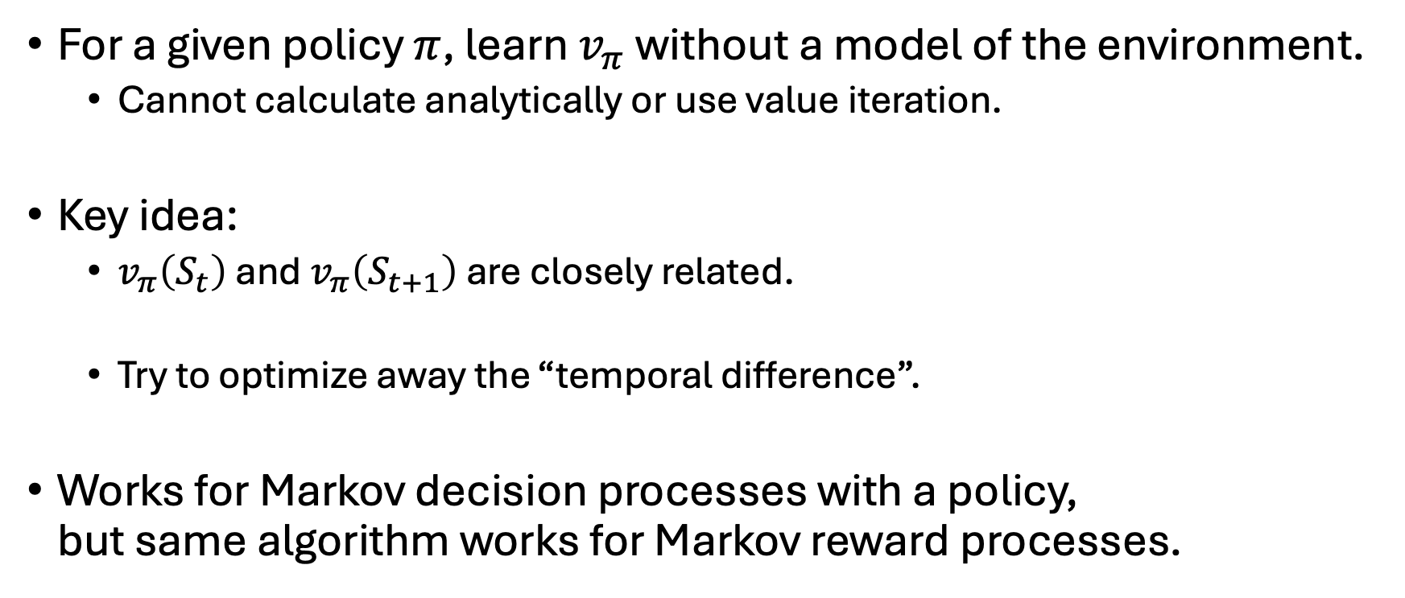
Temporal Difference (TD) Learning
For a given policy $π$, learn $v_{π}$ without a model of the environment.
Cannot calculate analytically or use value iteration.
Key idea:
$v_{π}\left(S_{t}\right)$ and $v_{π}\left(S_{t+1}\right)$ are closely related.
Try to optimize away the “temporal difference”.
Works for Markov decision processes with a policy, but same algorithm works for Markov reward processes.

Slide 8
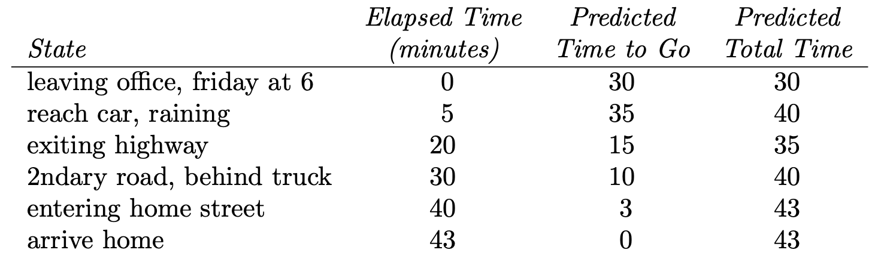
Driving Example (Sutton and Barto, 2020)

Slide 9
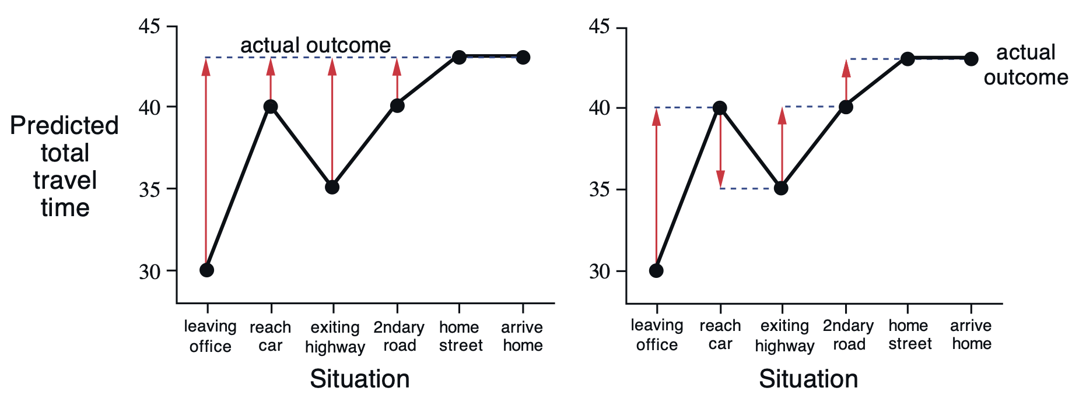
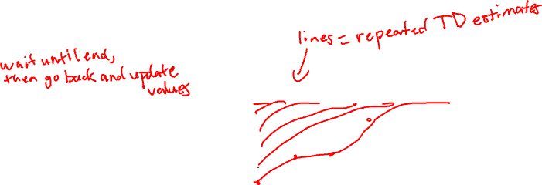
How Early Can a Prediction by Updated? (Sutton and Barto, 2020)

Slide 10
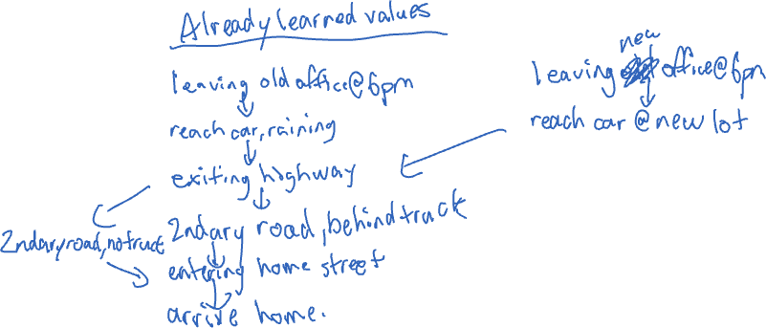
What if You Drive Home From a New Office? (Sutton and Barto, 2020)
???

Slide 11
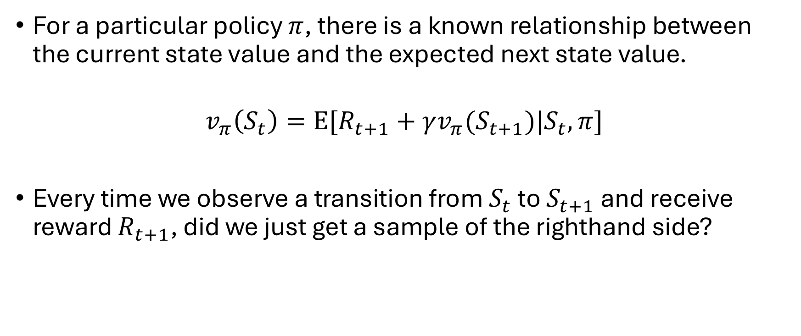
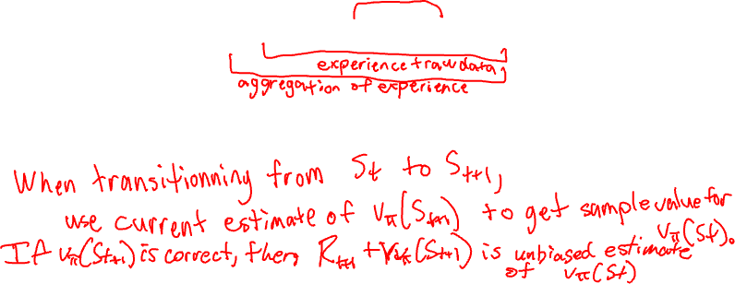
Intuition for TD Learning
For a particular policy $π$, there is a known relationship between the current state value and the expected next state value.
$$v_{π}\left(S_{t}\right)=E[R_{t+1}+γv_{π}(S_{t+1})|S_{t},π]$$
Every time we observe a transition from $S_{t}$ to $S_{t+1}$ and receive reward $R_{t+1}$, did we just get a sample of the righthand side?

Slide 12
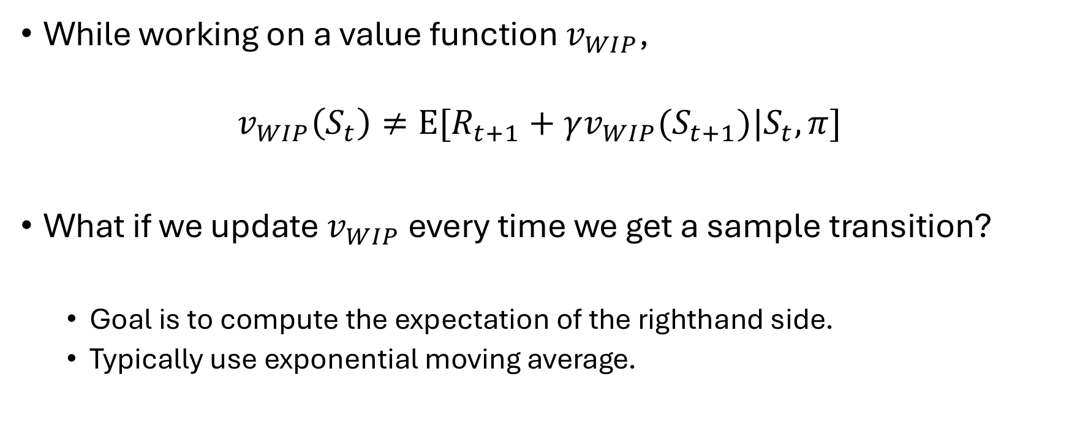
Inconsistencies in a Value Function
While working on a value function $v_{WIP}$,
$$v_{WIP}\left(S_{t}\right)≠E[R_{t+1}+γv_{WIP}(S_{t+1})|S_{t},π]$$
What if we update $v_{WIP}$ every time we get a sample transition?
Goal is to compute the expectation of the righthand side.
Typically use exponential moving average.

Slide 13
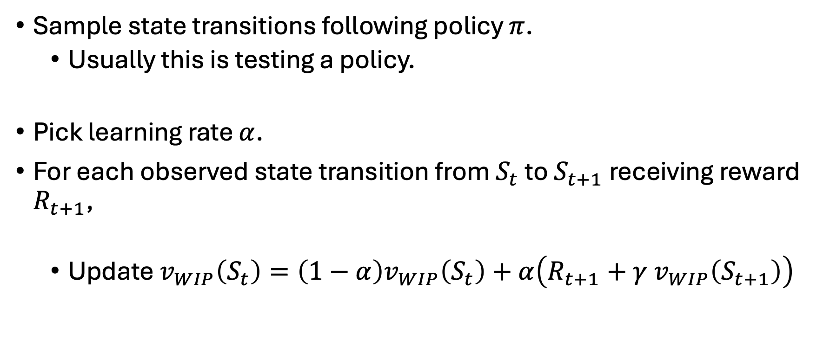

The Temporal Difference Learning Algorithm
Sample state transitions following policy $π$.
Usually this is testing a policy.
Pick learning rate $α$.
For each observed state transition from $S_{t}$ to $S_{t+1}$ receiving reward $R_{t+1}$,
Update $v_{WIP}\left(S_{t}\right)=\left(1−α\right)v_{WIP}\left(S_{t}\right)+α\left(R_{t+1}+γ v_{WIP}\left(S_{t+1}\right)\right)$

Slide 14
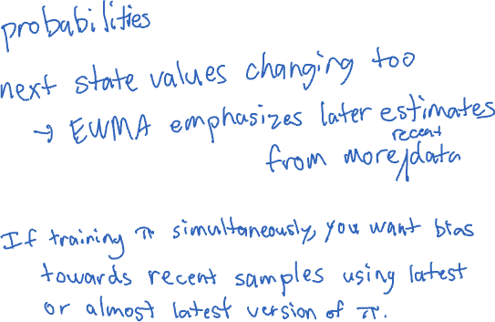
Why the exponential moving average?
???

Slide 15
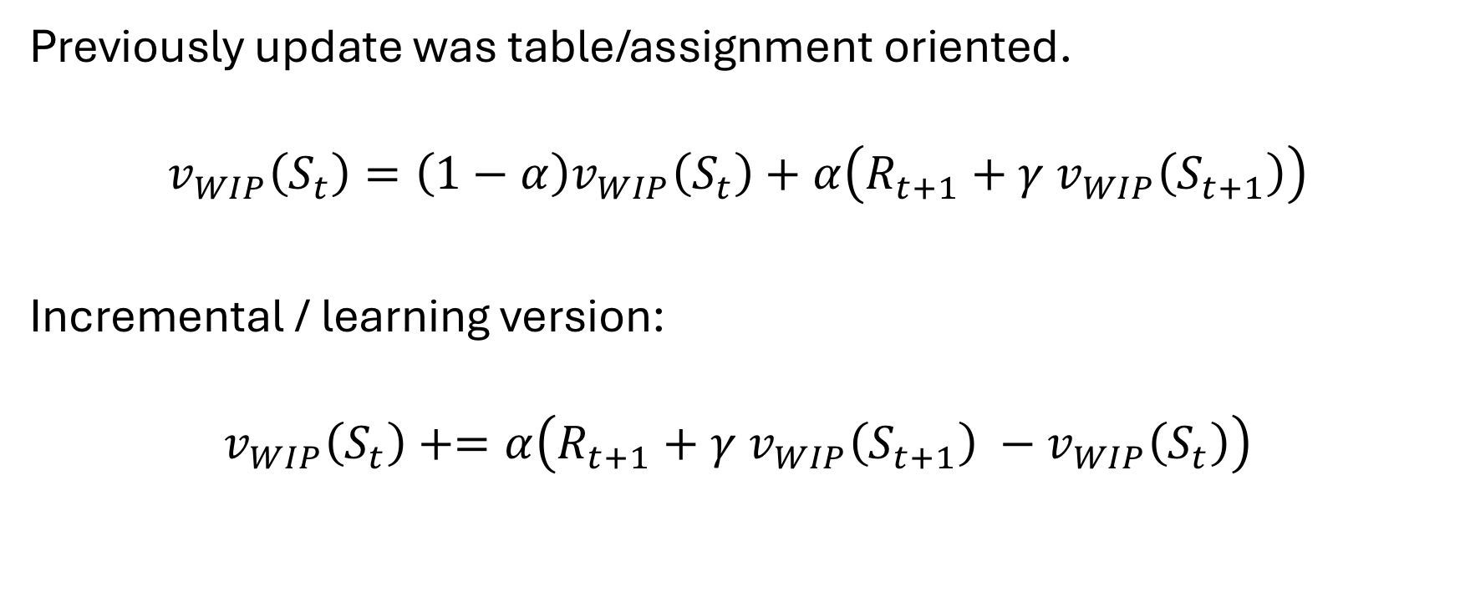
Temporal Difference Learning Reformulated
Previously update was table/assignment oriented.
$$v_{WIP}\left(S_{t}\right)=\left(1−α\right)v_{WIP}\left(S_{t}\right)+α\left(R_{t+1}+γ v_{WIP}\left(S_{t+1}\right)\right)$$
Incremental / learning version:
$$v_{WIP}\left(S_{t}\right)+=α\left(R_{t+1}+γ v_{WIP}\left(S_{t+1}\right) −v_{WIP}\left(S_{t}\right)\right)$$

Slide 16
Any Questions?
???

Slide 17
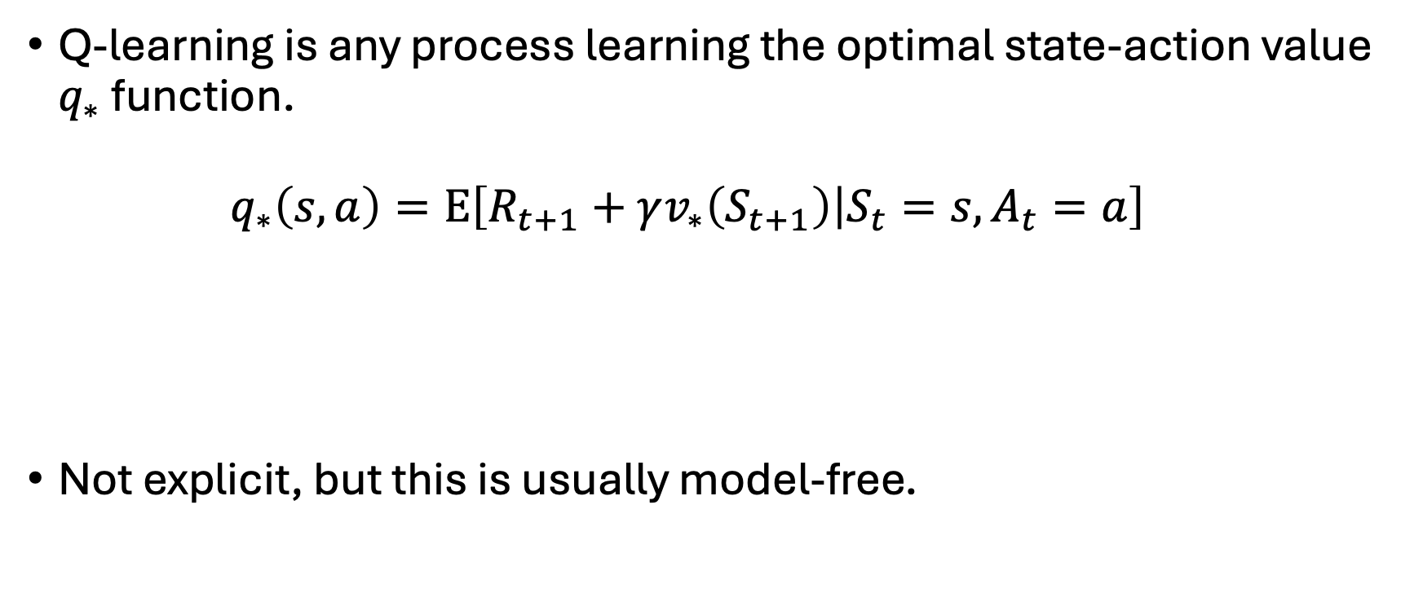

What is Q-Learning?
Q-learning is any process learning the optimal state-action value $q_{∗}$ function.
$$q_{∗}\left(s, a\right)=E\left[R_{t+1}+γv_{∗}\left(S_{t+1}\right) | S_{t}=s,A_{t}=a\right]$$
Not explicit, but this is usually model-free.

Slide 18
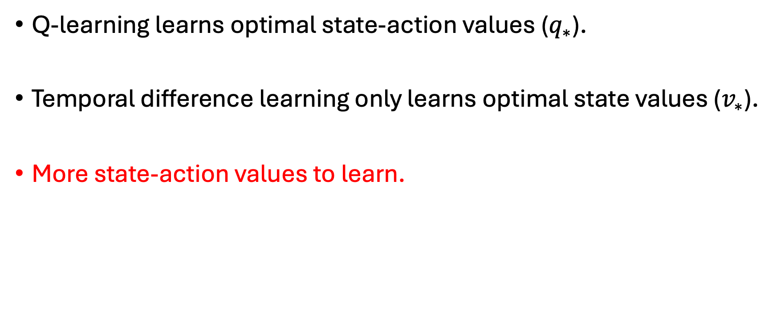
Q-Learning vs Temporal Difference-Learning
Q-learning learns optimal state-action values ($q_{∗}$).
Temporal difference learning only learns optimal state values ($v_{∗}$).
More state-action values to learn.

Slide 19
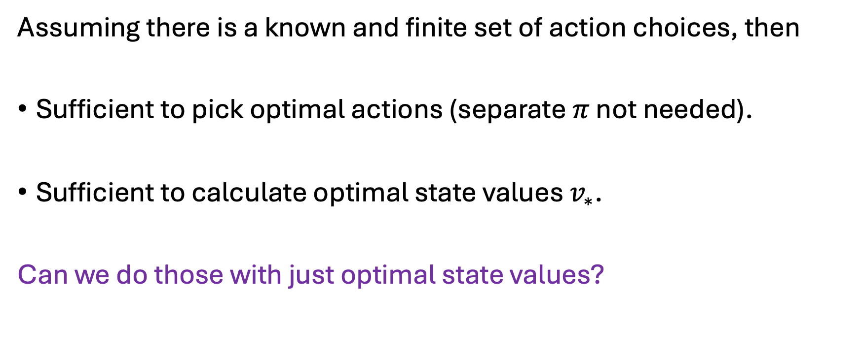
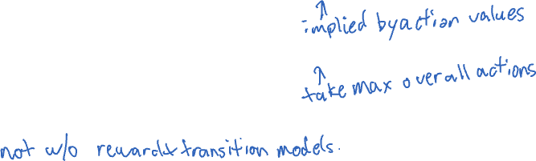
Why Q-Learning?
Assuming there is a known and finite set of action choices, then
Sufficient to pick optimal actions (separate $π$ not needed).
Sufficient to calculate optimal state values $v_{∗}$.
Can we do those with just optimal state values?

Slide 20

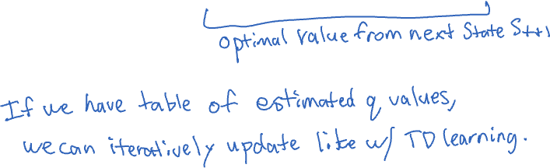
Recursive Definition of Q Values
$$q_{∗}\left(s, a\right)=E[R_{t+1}+\max_{a^{′}}{q_{∗}(S_{t+1},a^{′})}|S_{t}=s,A_{t}=a]$$

Slide 21
Will Exponential Moving Average Work Again?
???

Slide 22
What Order Should Q Values be Estimated?
???

Slide 23
Final States
Characterized by a reward and immediately stopping.
Typical implementation would be fixed reward and transition to do nothing sink state.
Handle these first.
Usually identified by problem definition.

Slide 24
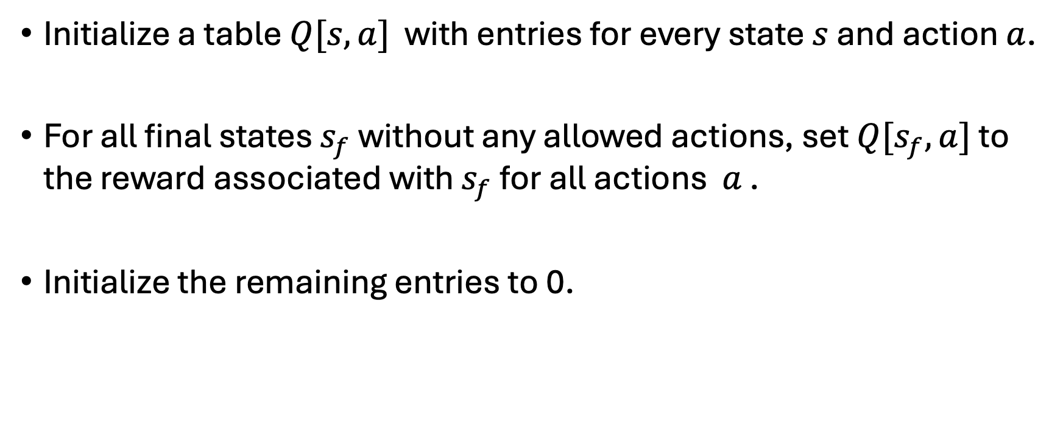
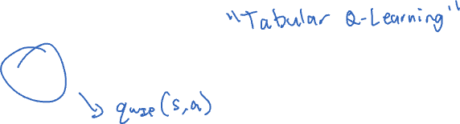
The Q-Learning Algorithm (initialization) (Watkins et al, 1992)
Initialize a table $Q[s,a]$ with entries for every state $s$ and action $a$.
For all final states $s_{f}$ without any allowed actions, set $Q[s_{f},a]$ to the reward associated with $s_{f}$ for all actions 𝑎 .
Initialize the remaining entries to 0.

Slide 25
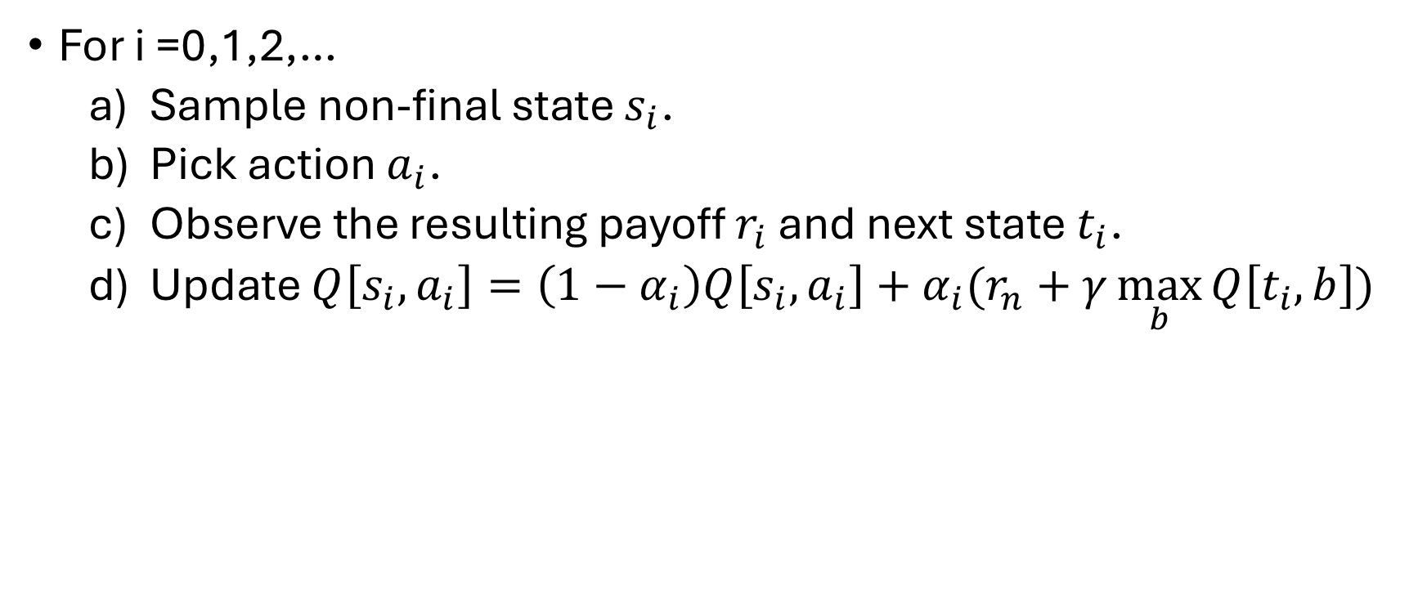
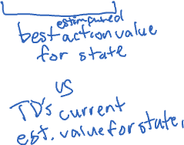
The Q-Learning Algorithm (learning) (Watkins et al, 1992)
For i =0,1,2,…
Sample non-final state $s_{i}$.
Pick action $a_{i}$.
Observe the resulting payoff $r_{i}$ and next state $t_{i}$.
Update $Q\left[s_{i},a_{i}\right]=\left(1−α_{i}\right)Q\left[s_{i},a_{i}\right]+α_{i}(r_{n}+γ\max_{b}{Q\left[t_{i}, b\right]})$

Slide 26
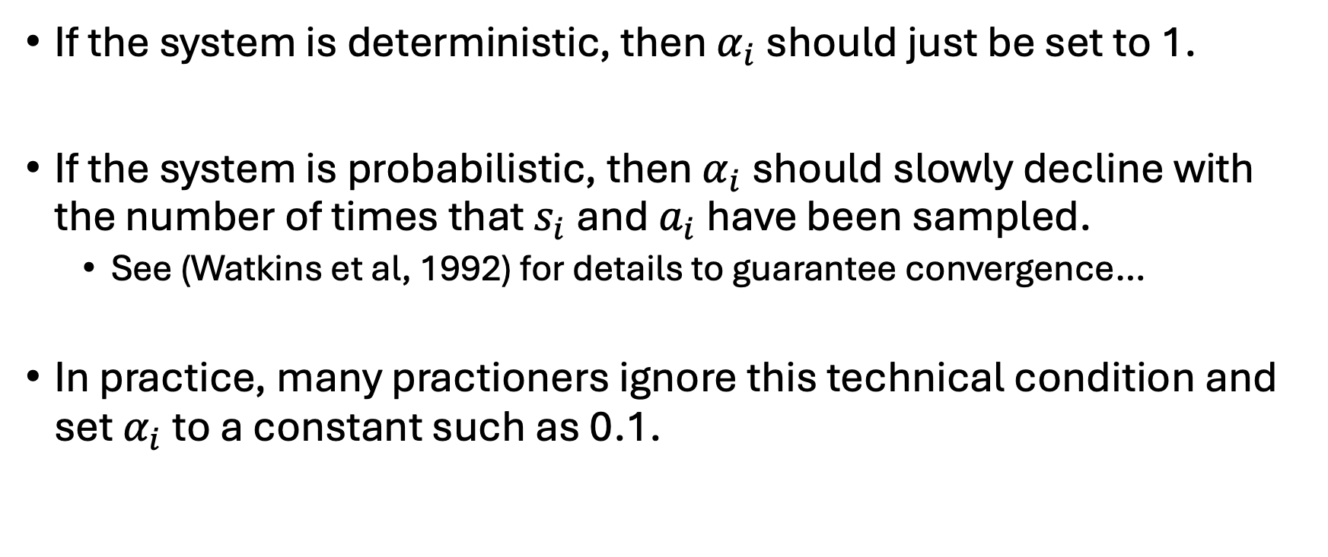
Learning Rate for Q-Learning
If the system is deterministic, then $α_{i}$ should just be set to 1.
If the system is probabilistic, then $α_{i}$ should slowly decline with the number of times that $s_{i}$ and $a_{i}$ have been sampled.
See (Watkins et al, 1992) for details to guarantee convergence…
In practice, many practioners ignore this technical condition and set $α_{i}$ to a constant such as 0.1.

Slide 27
How to Sample for Q-Learning
???

Slide 28
So How Did TD- and Q-Learning Work Around the Lack of Model?
???

Slide 29
Are TD- and Q-Learning Solving or Learning?
???

Slide 30
Any Questions?
???

